Slide 1

FINAL YEAR RESEARCH PROJECT
Review-1 Presentation Autism Disorder Prediction System Using Machine Learning
Supervised By: Mr. Jason Marandi
Group No.:19-07
Name of the Student(s) with Regd. No.:
1. Snehajeet Jena - 2241010058
2. Debasish Patra - 2241016266
3. Abhipsa Padhi - 2241016005
4. Aditya Padhi - 2241016007
Department of Computer Sc. and Engineering
Faculty of Engineering & Technology (ITER)
Siksha ‘O’ Anusandhan (Deemed to be) University
Bhubaneswar, Odisha

Slide 2
Presentation Outline
Problem Statement & Motivations
Problem Statement
Motivations
Literature Review
Existing Solutions & Limitations
Proposed Methodology & Approach
Key Components/Modules & Algorithms Used
Dataset & Tools/Technologies
Work Done So Far (Implementation Progress)
Preliminary Results (if any)
Future Work Plan
References

Slide 3
Problem Statement
Autism Spectrum Disorder (ASD) is a complex neurodevelopmental condition affecting communication, social interaction, and behavior.
Symptoms vary widely across individuals, making early identification difficult.
Current diagnosis methods rely heavily on behavioral assessments and expert evaluation.
Traditional approaches are time-consuming, subjective, and not easily accessible, especially in rural areas.
Delayed diagnosis reduces the effectiveness of early intervention and support.
There is a need for a fast, reliable, and data-driven system for early autism prediction.

Slide 4
Motivations
Increasing prevalence of Autism Spectrum Disorder (ASD) worldwide.
Early detection is crucial for effective intervention and improved outcomes.
Traditional diagnostic methods are time-consuming and dependent on experts.
Limited accessibility of specialized healthcare in rural and underdeveloped areas.
Need for a fast, cost-effective, and scalable screening system.
Machine Learning enables data-driven, accurate, and automated prediction.

Slide 5
Literature Review
Table 1:Summary of Existing Approaches and Research Limitations
S. No. | Author & Year | Methods/Techniques Used | Dataset Used | Research Outcomes | Findings
1 | S. M. Mahedy Hasan (2023) | • Feature Scaling (QT, PT, Normalizer) • AdaBoost, RF, DT, KNN, NB, LR, SVM, LD | ASD Toddlers Dataset ASD Children Dataset ASD Adolescents Dataset ASD Adults Dataset | 99.25% (AdaBoost – Toddlers) 99.03% (LDA – Adults) | Feature scaling improves accuracy; no single best mode
2 | Prasenjit Mukherjee (2023) | • NLP (Sentiment Analysis) • SVM, LR, KNN, RF • AdaBoost | Autism Spectrum Disorder Screening Datasets(ASD_Symptoms.csv) | 67% using SVM | Lack of Feature Engineering;; effective for structured data
3 | Abdelwahab Ridlan. (2024) | LR, SVM, Random Forest, KNN, Decision Tree (C4.5) | Autism Screening Adult Data Set | 94% accuracy using C4.5 algorithm | Decision tree (C4.5) outperforms linear regression
4 | Mahmoud M. Abdelwahab (2024) | ANN, SVM, Decision Tree, KNN, Random Forest | ASD Screening Data for Adult, Children, and Adolescent(UCI and Kaggle) | 99.75% accuracy using Random Forest | Random Forest outperforms all other models with highest accuracy in ASD prediction
5 | Rasul et al. (2024) | SVM, LR, ANN + Clustering + Feature Selection | ASD Screening Combined Data(Children + Adult) | 94.24% accuracy using ANN (Combined dataset) | ANN performs best for combined dataset; model performance improves with feature selection and hyperparameter tuning
6 | R. Surendiran (2022) | • ANN, SVM, KNN, DT, RF • Feature Selection | ASD Screening Dataset (Adult, Children, Adolescent) | 97.68% accuracy using ANN | ANN achieves highest accuracy; feature selection reduces dimensionality and improves prediction

Slide 6
Research Gap
Most studies focus on post-diagnosis or complex clinical data, not early screening.
Lack of feature engineering to extract meaningful insights.
Class imbalance issues not properly handled.
Limited focus on scalable and user-friendly systems.
Existing models lack generalization on unseen real-world data.

Slide 7
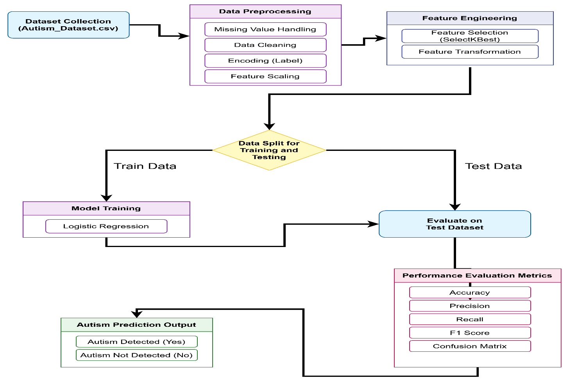
Proposed Solution & Architecture
Fig. 1: Workflow of the Proposed Model

Slide 8
Dataset
Table 2: Summary of Experimental Dataset
The dataset is a merged autism screening dataset collected from Kaggle and UCI Machine Learning Repository, where both sources had similar features, so they were combined to increase data size and improve model performance.
It is a tabular dataset for binary classification, containing features like age, gender, medical history (jaundice), and AQ-10 behavioral scores (A1–A10), which represent autism-related traits .
The target variable is Class/ASD (0 or 1), where the model predicts whether a person has autism or not based on behavioral and demographic features.
Dataset Name | Task Type | Dataset Type | Sample Size | Feature size | Data Split Ratio(%)
Autism_Dataset | Binary-Classification | Tabular | 2000 | 16 | 80-20

Slide 9
Tools/Technologies
Table:03 Summary of Tools and Technologies
Category | Tools/Technologies
Programming Language | Python
Data Handling | Pandas, NumPy
Data Visualization | Matplotlib, Seaborn
Data Preprocessing | LabelEncoder, PowerTransformer
Machine Learning Model | Logistic Regression
Model Optimization | GridSearchCV
Model Evaluation | Accuracy, Confusion Matrix, Classification Report
Framework/Library | Scikit-learn
Development Environment | Jupyter Notebook / VS Code
Model Saving | Pickle

Slide 10
Progress in Implementation Plan & Methodology
Dataset Collection
The dataset was collected from Kaggle and UCI Machine Learning Repository, similar to the paper which also used multiple ASD datasets across age groups.
Both datasets contained AQ-based behavioral features, which are widely used in autism screening as mentioned in the paper.
The datasets were merged since they had similar feature structures, increasing data size and improving model robustness
Data Preprocessing
Missing values were handled, similar to the preprocessing steps.
Categorical features were encoded into numerical values, as required for ML models using label encoding.
Feature scaling was applied to normalize data, which improves model performance.
Data cleaning was performed to remove inconsistencies and noise.
Feature Engineering
Applied feature selection using SelectKBest to choose important features..
Removed irrelevant or redundant features to reduce complexity..
Transformed features to improve data representation.

Slide 11
Progress in Implementation Plan & Methodology(Contd…)
Data Splitting
Divided dataset into training and testing sets (80:20 ratio).
Training data used for learning patterns by the model.
Testing data used for evaluating model performance.
Model Training (Logistic Regression)
Selected Logistic Regression for binary classification.
Trained model using training dataset..
Learned relationship between input features and target output..
Prepared model for prediction and evaluation.
Model Evaluation
Evaluated model using test dataset.
Used multiple metrics: accuracy, precision, recall, F1-score.
Compared predicted vs actual values.
Prediction Output
Generated final prediction based on trained model.
Classified output as Autism (Yes) or No Autism (No).

Slide 12
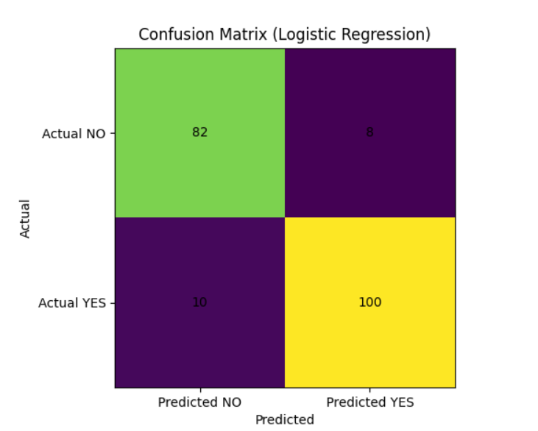
Result Analysis
Correct Predictions
The model correctly predicted 82 non-autism (TN) and 100 autism cases (TP), showing strong overall performance.
Errors Made by Model
There are 8 false positives (wrongly predicted autism) and 10 false negatives (missed autism cases), which are relatively low.
.
Fig 02: Confusion Matrix

Slide 13
Result Analysis(Contd…)
Table:-04 Model performance of the Autism Dataset
Model | Accuracy | Precision | Recall | F1-Score
Logistic Regression | 90% | 0.89 | 0.91 | 0.90

Slide 14
Future Work Plan
Model Optimization (All Algorithms)
Improve performance of Logistic Regression, KNN, Decision Tree, and Random Forest using hyperparameter tuning (Grid Search / Random Search).
Advanced Ensemble Techniques
Combine models using techniques like Voting or Stacking to achieve better accuracy than individual models.
Improving KNN & Decision Tree Performance
Optimize K value in KNN and apply pruning in Decision Tree to reduce overfitting and improve generalization.
Real-Time Deployment & Testing
Deploy the best-performing model as a web application and test it with real-time user input for practical validation.

Slide 15
References
[1] | Tourt, Dara, Queen E. Booker, and Carl M. Rebman Jr. "Strategic application of SMOTE and its variants to enhance AI-driven healthcare classification in imbalanced datasets." Issues in Information Systems 26.2 (2025).
[2] | Ridlan, Ahmad, et al. "Early autism disorder prediction using machine learning." International journal of open information technologies 13.1 (2025): 48-53.
[3] | Abdelwahab, Mahmoud M., et al. "Autism spectrum disorder prediction in children using machine learning." Journal of Disability Research 3.1 (2024): 20230064.
[4] | Surendiran, R., et al. "Effective autism spectrum disorder prediction to improve the clinical traits using machine learning techniques." Int J Eng Trends Technol 70.4 (2022): 343-59.
[5] | Rasul, Rownak Ara, et al. "An evaluation of machine learning approaches for early diagnosis of autism spectrum disorder." Healthcare Analytics 5 (2024): 100293.
[6] | Hasan, SM Mahedy, et al. "A machine learning framework for early-stage detection of autism spectrum disorders." IEEE Access 11 (2022): 15038-15057.

Slide 16


